Slide 1

Smart Waste Management for Sustainable Cities
Optimizing Collection, Air Quality, and Urban Safety

Slide 2
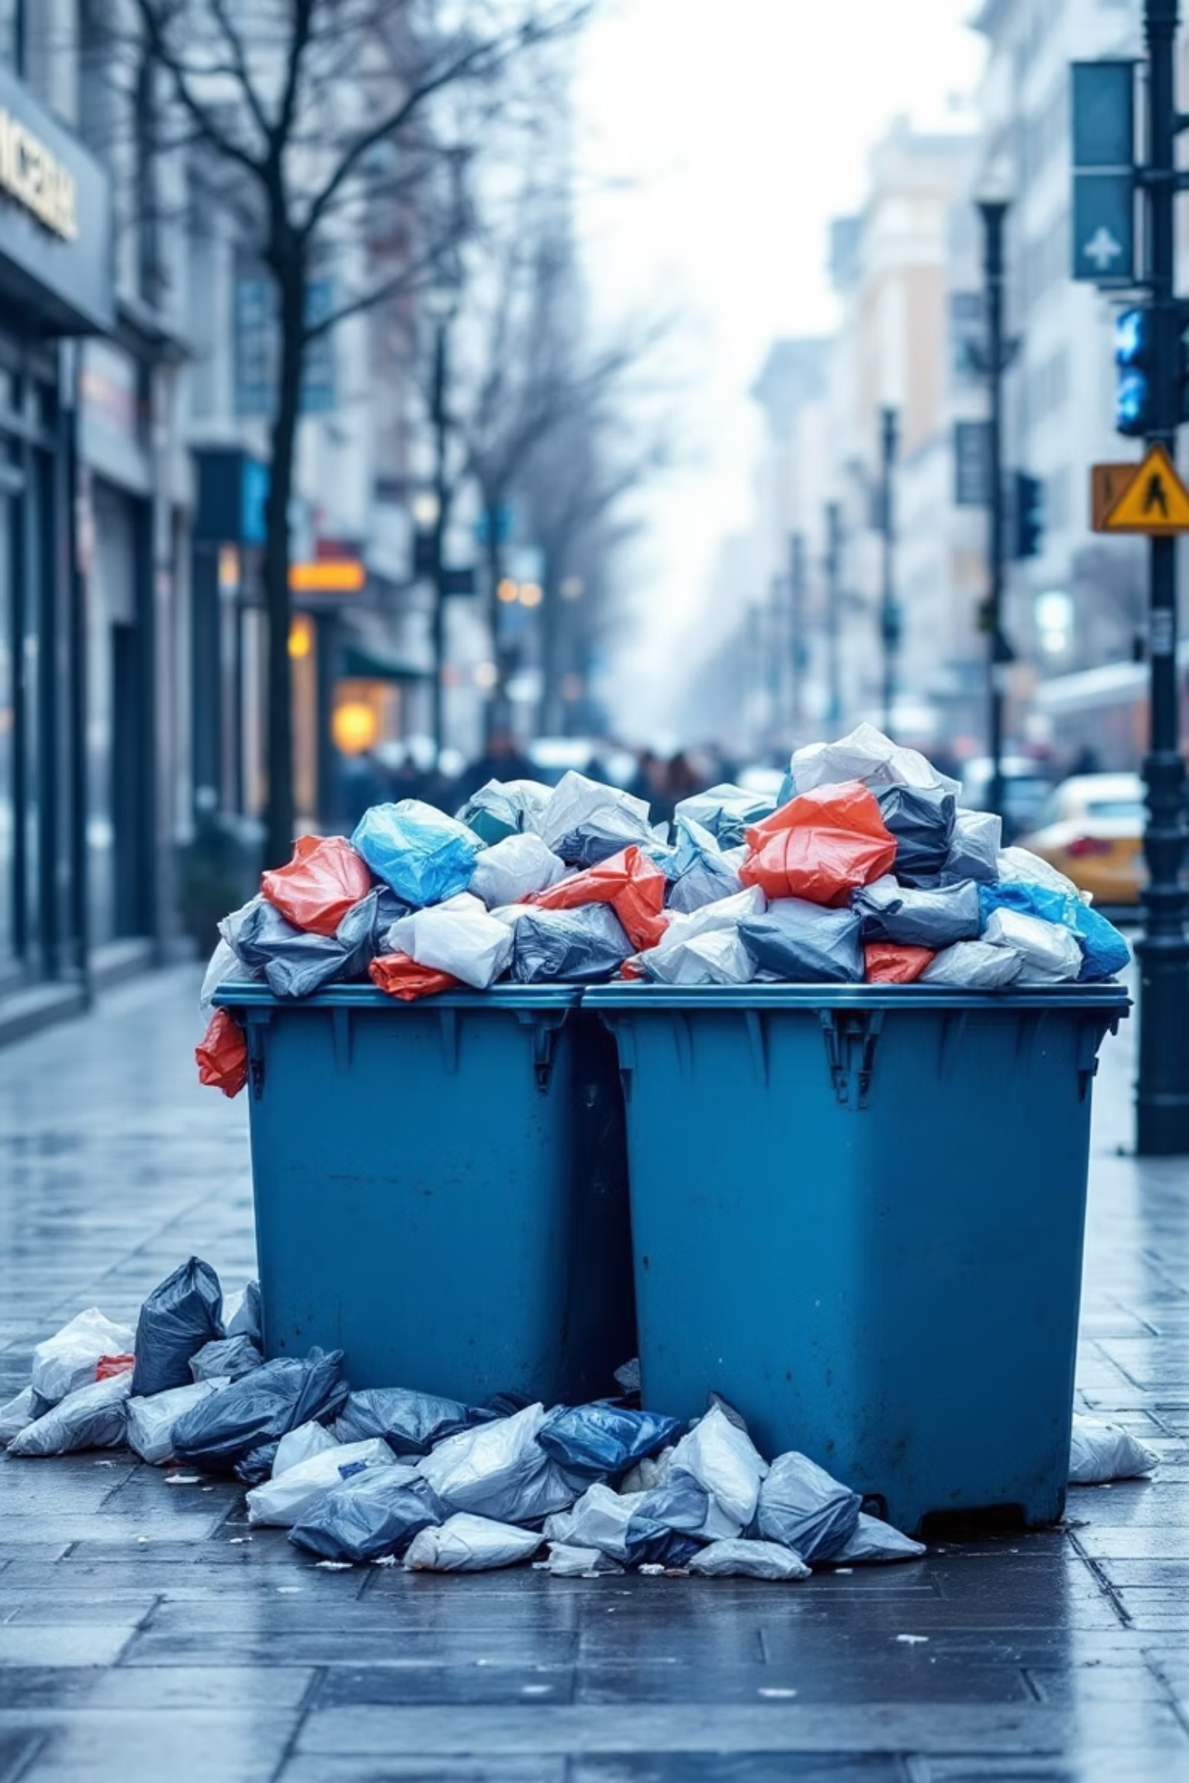
The Urban Waste Crisis: A Growing Challenge
Overflowing Bins
Inefficient Routes
Environmental Impact

Slide 3
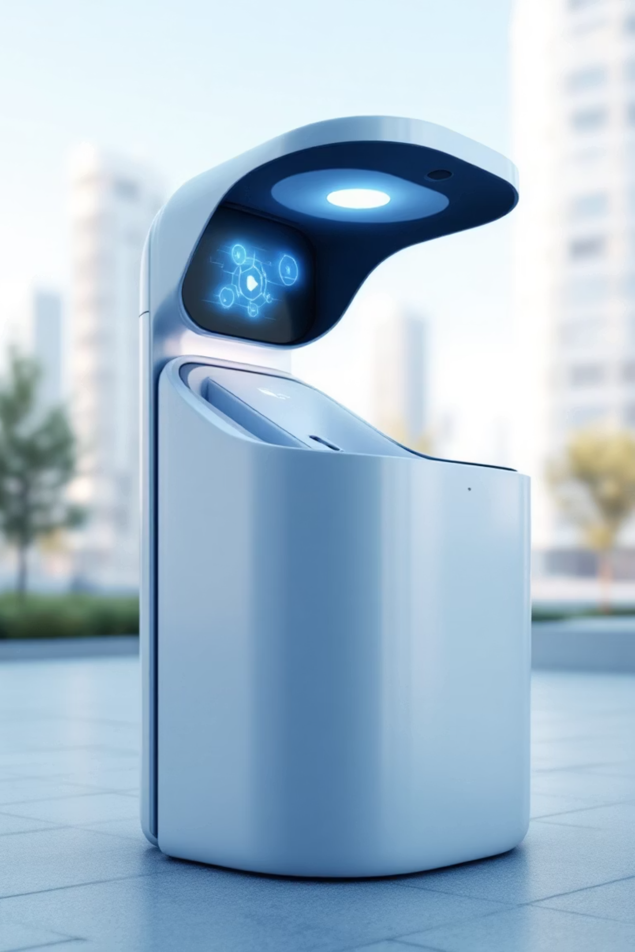
Introducing Our Smart Waste Platform
IoT sensors, and cloud analytics
Real-time monitoring and proactive management

Slide 4
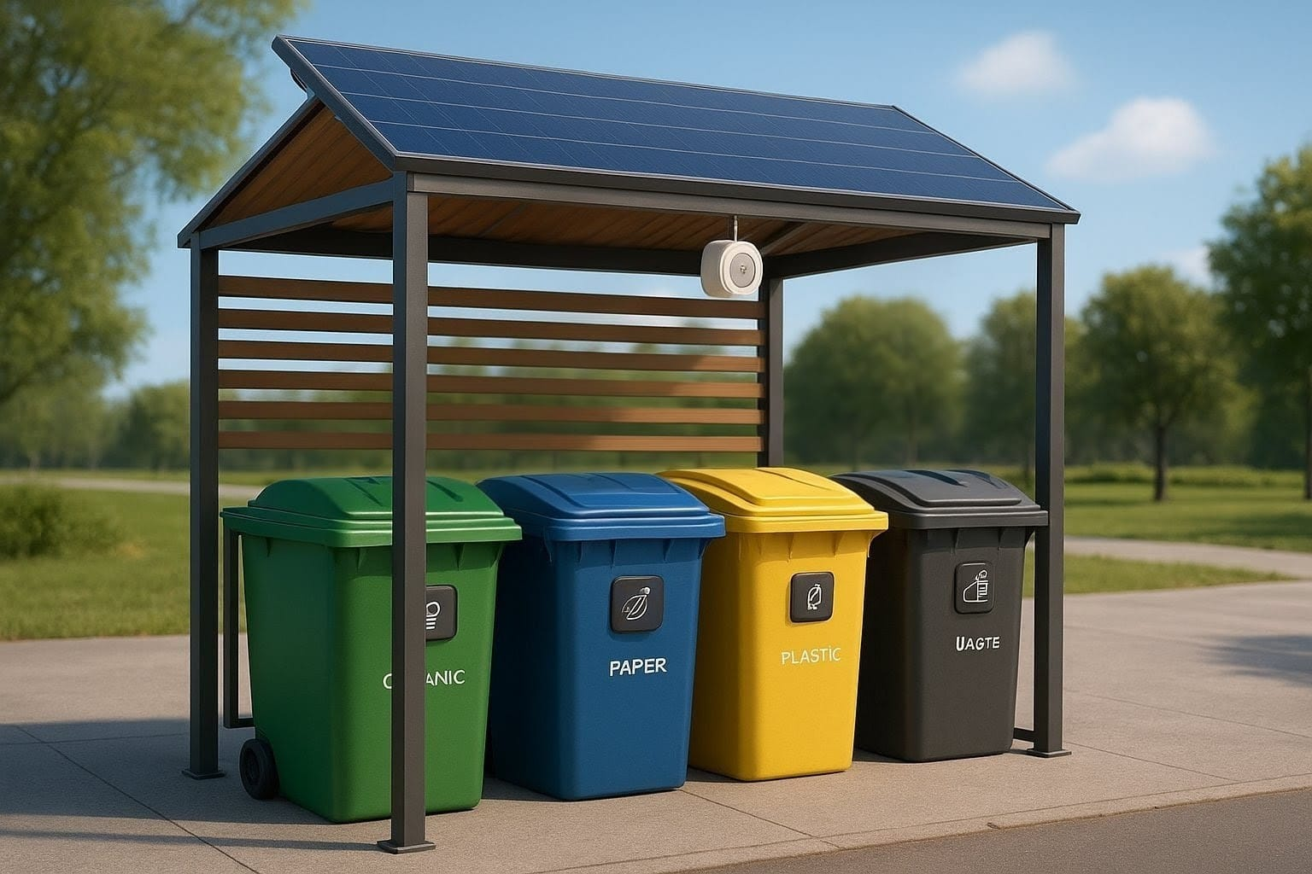

Slide 5
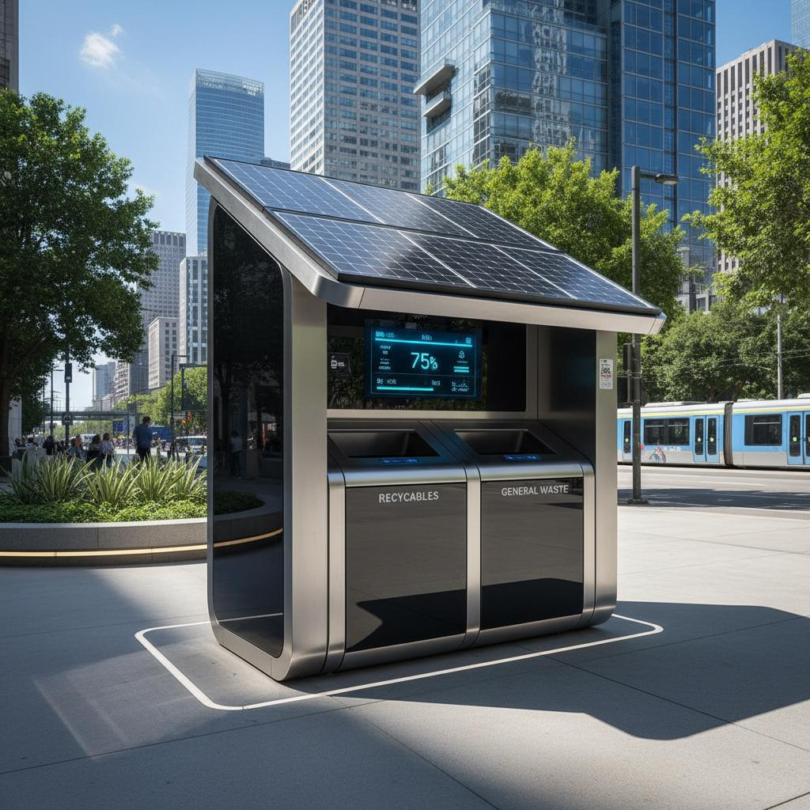
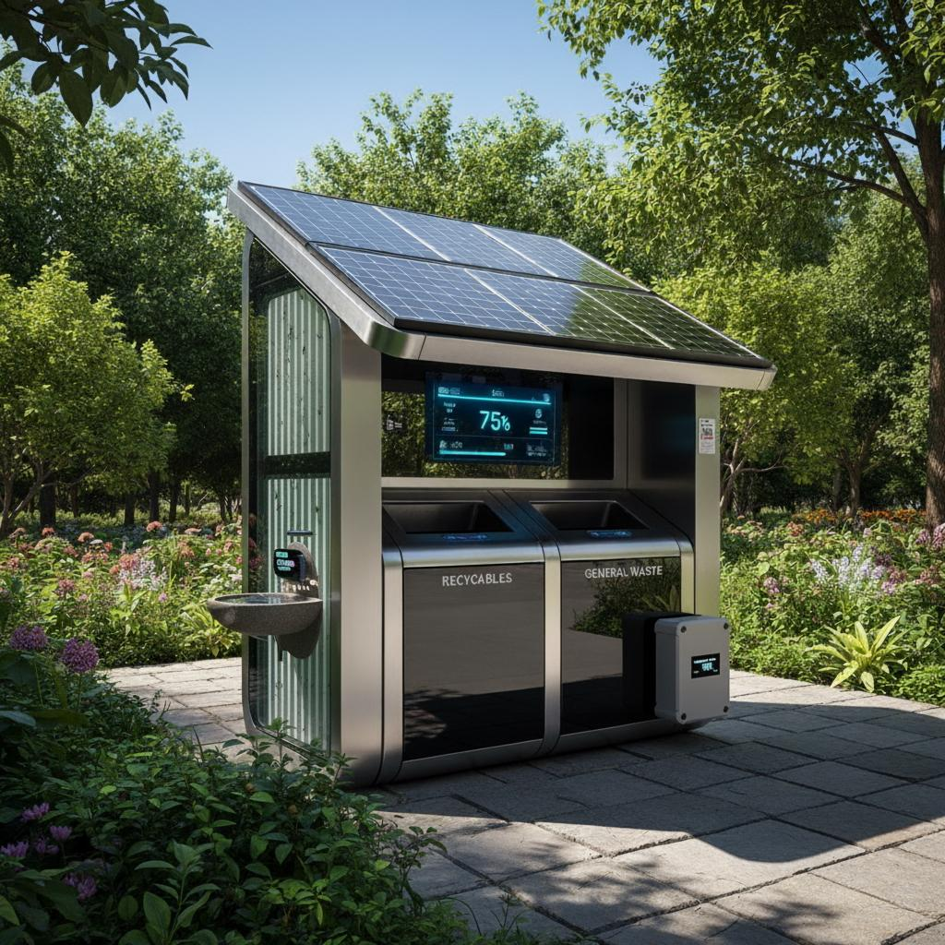

Slide 6






Advanced Sensor Technology for Smarter Bins
Ultrasonic Sensor
Tilt Sensor
Flame Detector
MQ-2 Gas Sensor
Temp & Humidity
IR + Photoresistor

Slide 7
System Architecture: Data Flow & Intelligence
Seamless data flow
Intelligent analytics, driving efficient operations.
Real-time data
Cloud platform

Slide 8
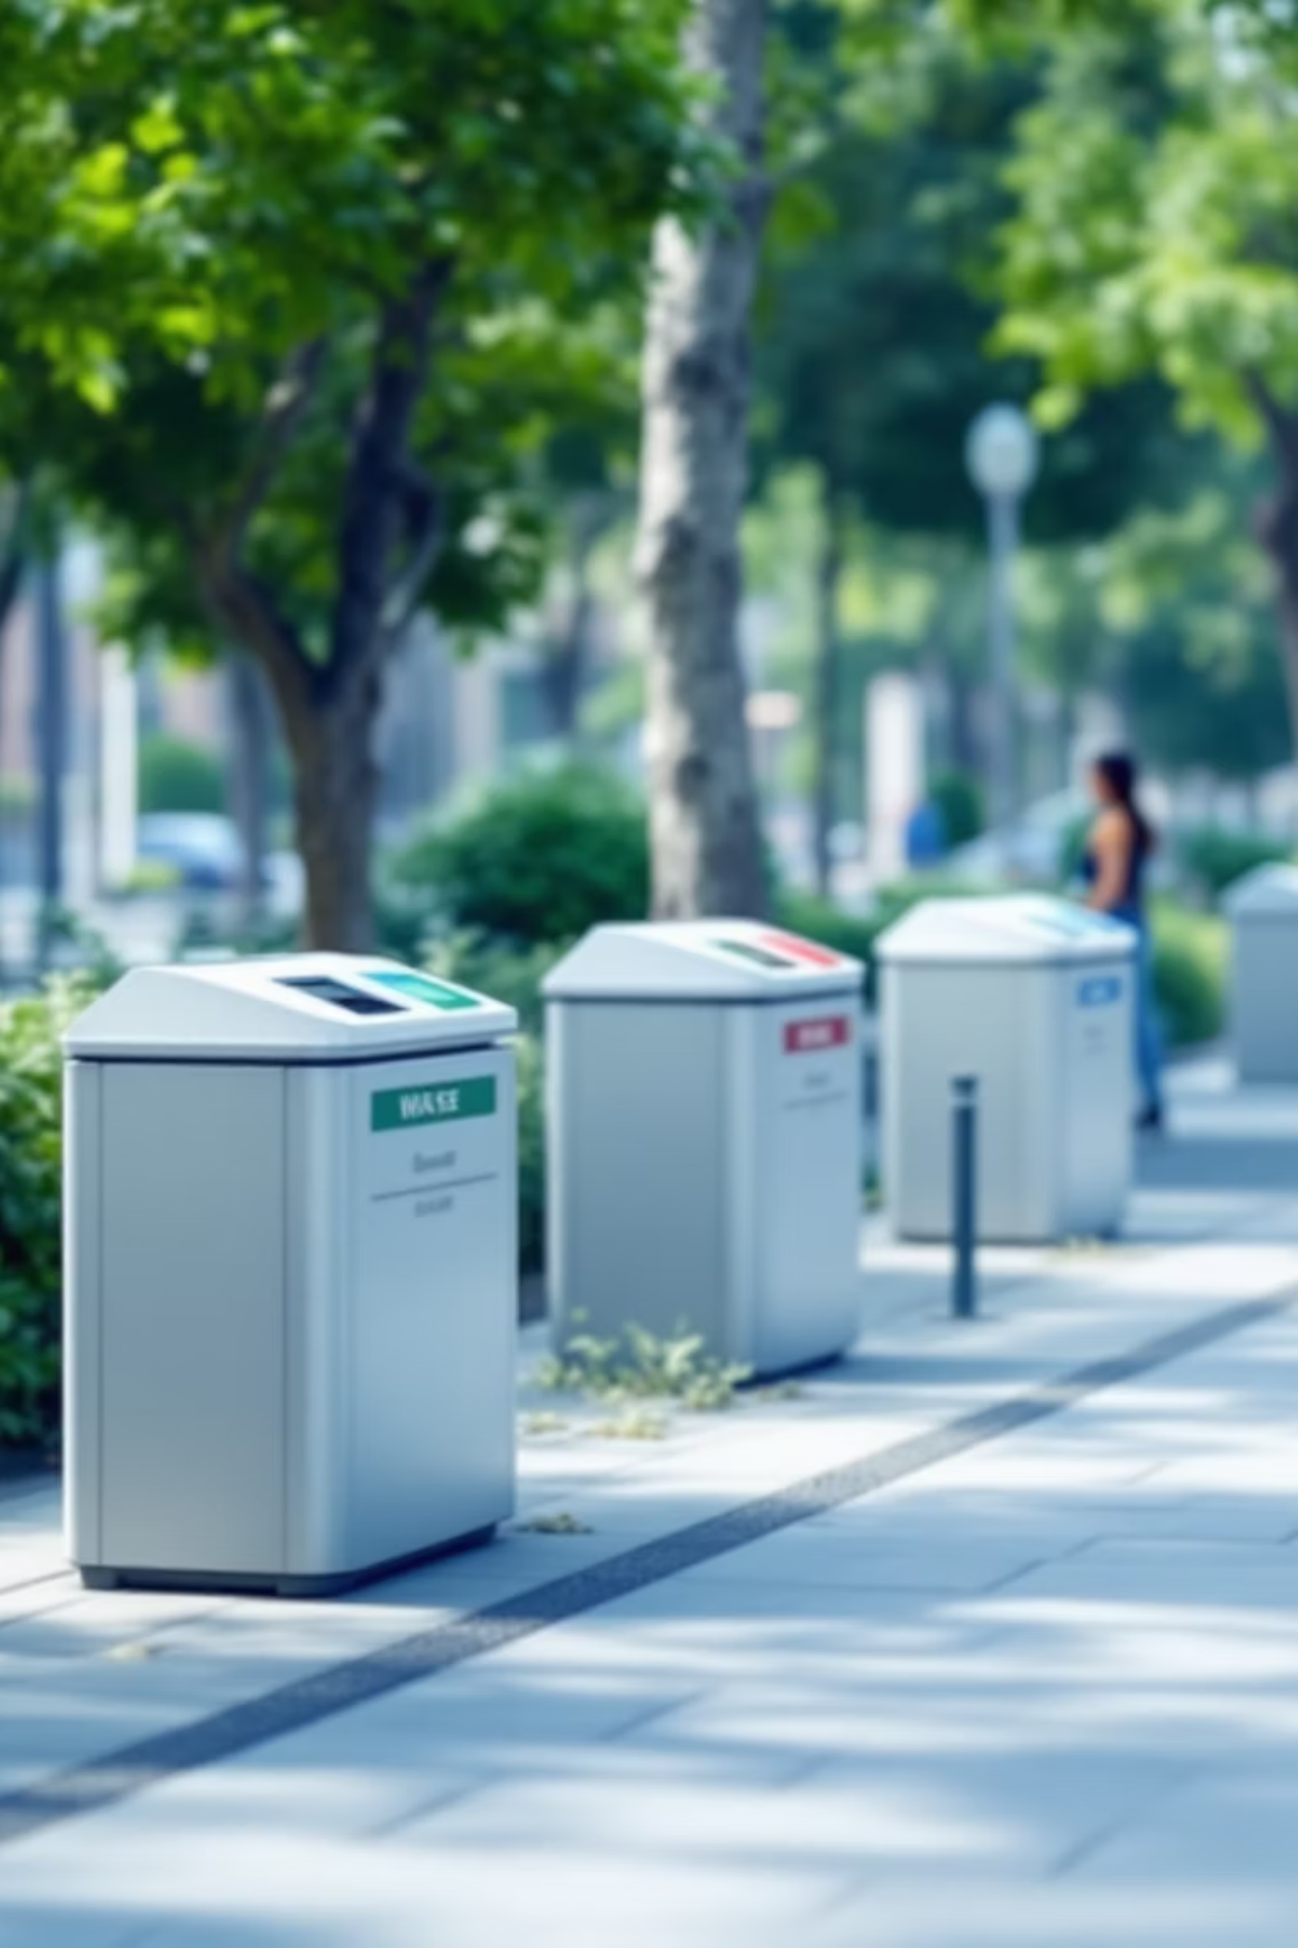



Transformative Benefits for Smart Cities
Economic Efficiency
Enhanced Social Well-being
Environmental Sustainability

Slide 9





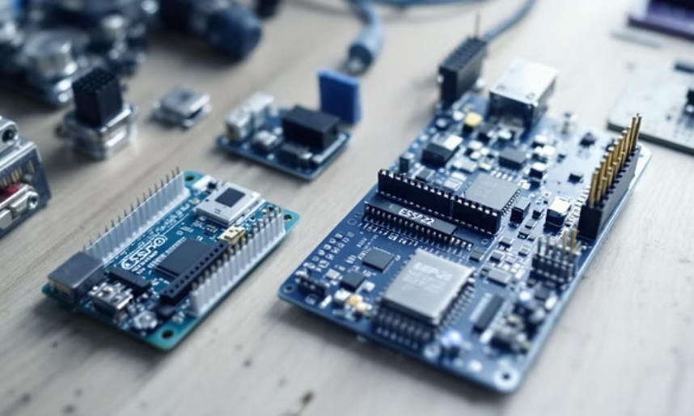

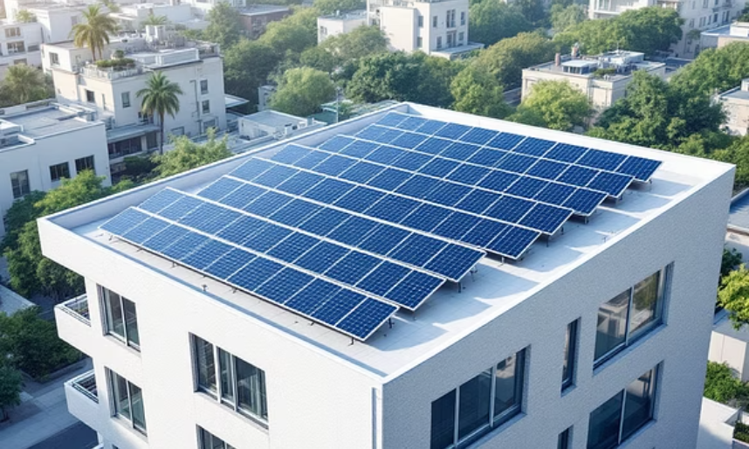
Human-Centric Design
No more overflowing bins
Lower costs
Efficient services
Data-driven decisions

Slide 10

Visualizing Impact: A Smarter City Map
Intelligent collection routes
Monitoring eco-friendly zones
Optimized urban environment
Dynamic routing

Slide 11

Market Opportunity & Scalability
Market is poised for significant growth
Global deployment
Adaptable to all cities

Slide 12

Invest in a Smarter, Sustainable Future
Proven Components
Enhanced QoL
Eco-Leadership
Scalable Solution
Join us in building the next generation of intelligent urban infrastructure.

